Slide 1
MTC DETEC LTD
PRESENTATION ON APPLICATION FOR VALUE ADDED SERVICE AUTHORIZATION

Slide 2
OUTLINE
COMPANY HISTORY
PRODUCTS AND SERVICES
SERVICE DESCRIPTIONS
RESOURCES NEEDED
TECHNICAL IMPLEMENTATION
COMPLAINT HANDLING PROCEDURE
CONCLUSSION AND RECOMMENDATIONS

Slide 3
INTRODUCTION
MTC DETEC LTD is a pioneering telecommunications company seeking Value Added Service Authorisation. 4th May 2023
MTC DETEC LTD was formed after COVID19 where technology has changed the people do things and the rate at which information and communication is in high demand, the CEO and Partner has decided to also play a roles in the Tech-world
Our mission is to provide cutting-edge Telecommunication Value Added Services that are not only affordable but also specifically tailored to meet the evolving needs of our clients.
Our vision is to become the leading provider of cutting-edge telecommunications solutions in Ghana, recognized for our unwavering commitment to customer satisfaction, innovation, and social responsibility.
Individual
Corporates
Educations
The Company is a Limited Liability Company and the CEO under is Mr. Matthew Kofi Amuzu

Slide 4
PRODUCTS AND SERVICES
Short Message Service (SMS)– Non-Expiry Volume based
Unstructured Supplementary Service Data (USSD)- Monthly Subscription
Video Content- Package Subscription
Sales of Data and Airtime- Package Subscription
Mobile Gaming Applications- Package Subscription

Slide 5
SMS SOLUTIONS
Our SMS solutions provide businesses with powerful tools to engage customers through targeted messaging campaigns
Leveraging advanced analytics and segmentation, we deliver personalized SMS content that drives customer engagement, loyalty, and conversions.

Slide 6
SMS SOLUTIONS
Our solution is to develop a Bulk SMS platform where our customers can be able to send bulk SMS to their client at ease
Leveraging advanced analytics and segmentation, we deliver personalized SMS content that drives customer engagement, loyalty, and conversions.

Slide 7

FEATURES OF SMS SOLUTION
Bulk SMS Messaging
SMS Automation
Two-Way SMS Communication
Personalized SMS Campaigns
SMS Integration

Slide 8
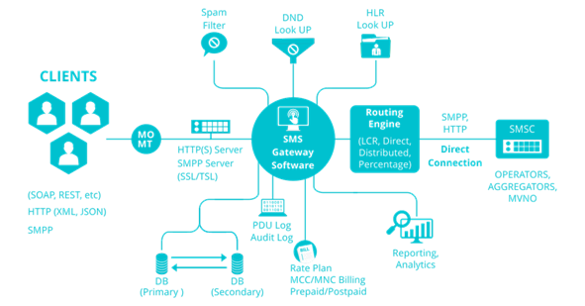
IMPLEMENTATION PLAN FOR SMS SOLUTIONS

Slide 9
USSD APPLICATIONS
Our USSD applications offer businesses a direct and efficient communication channel to interact with customers, facilitate transactions, and deliver value-added services.
With intuitive interfaces and secure protocols, our USSD solutions empower businesses to optimize customer interactions and drive revenue growth.

Slide 10
USSD APPLICATIONS DETAILS
We will develop USSD application which will help our video and SMS application.
This is to help our customers to subscribe to our service with ease.
We will also integrate with our third parties USSD APIs to help our clients enjoy other service from our partners

Slide 11
FEATURES OF USSD APPLICATION
USSD Applications Development
Transactional USSD Services
Interactive USSD Menus
Personalized USSD Messaging:
USSD Integration

Slide 12
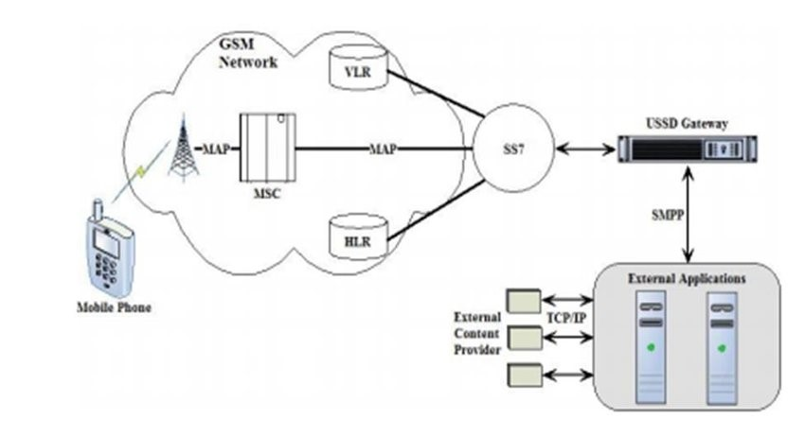
IMPLEMENTATION FOR USSD

Slide 13

VIDEO CONTENT DELIVERY SERVICES
We specialize in delivering high-quality video content to subscribers across Ghana
From entertainment to educational content, our video delivery services utilize robust streaming technology to ensure seamless playback on any device, enhancing user experience and engagement.
And our focus is to introduce subject course videos, infotainments and other learning contents.
This is to engage both lectures, teachers and students after normal lesson hours.
Our video content is to help student to learn full practical courses in the comfort of their homes and convenient places.

Slide 14
MODE OF SUBSCRIPTION
Subscription will be done using mobile app where customers will download apps from iOS and android stores
Other form of subscription will be done using USSD platform where customer will register and using short-code interaction menu.

Slide 15
MODE OF UN-SUBSCRIPTION
Subscriber who wish not to use our service can chose to delete the apps from his device
Other way to unsubscribe is to use our short-code interactive menu to unregister. The customer will not be deleted entire but will be set to dormant customer.

Slide 16
FEATURES OF VIDEO CONTENT DELIVERY SERVICE
Content Streaming Platforms Integration
Live Video Streaming Solutions
Personalized Recommendations
Interactive Features
Content Monetization Strategies

Slide 17
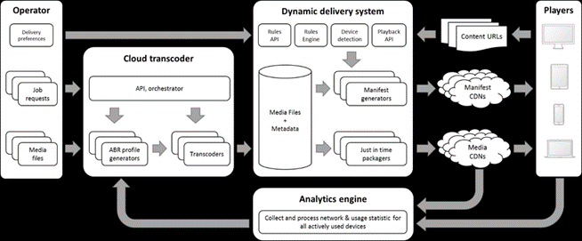
IMPLEMENTATION PLAN FOR VIDEO CONTENT

Slide 18
SALES OF DATA AND AIRTIME
Our platform facilitates the sale of data bundles and airtime top-ups, providing customers with convenient access to essential telecommunications services.
With secure payment options and real-time delivery, we ensure a seamless purchasing experience for users, driving revenue and customer satisfaction.
Data Bundles and Plans: We will offer a variety of data bundles and plans tailored to the needs and preferences of individual users. From daily, weekly, and monthly packages to customized plans based on usage patterns, our offerings will cater to a diverse range of data requirements.
Airtime Top-Ups: Users will have the option to conveniently top up their airtime balance using VAS technology. Whether through direct purchases or automated recurring top-ups, individuals can ensure uninterrupted connectivity and communication on their mobile devices.

Slide 19
FEATURES OF DATA AND AIRTIME
Promotions and Discounts
Integration with Payment Gateways
Personalized Recommendations

Slide 20
FEATURES OF DATA AND AIRTIME
Reward packages will also be given to our loyal customer
Airtime and data will be given to customers who refers a customer
We will integrate with our third-party telco to be able to send data and air time

Slide 21
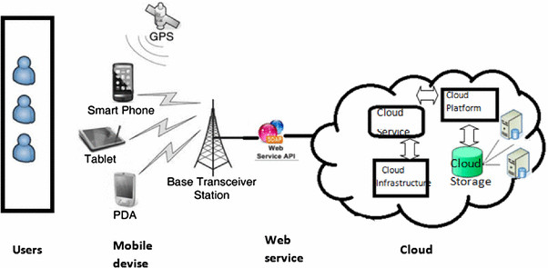
IMPLEMENTATION PLAN

Slide 22

MOBILE GAMING APPLICATION (FUTURE BUSINESS)
Our mobile gaming applications offer users immersive and captivating gaming experiences while providing businesses with opportunities for brand integration, sponsorship, and monetization.
From casual games to multiplayer experiences, our gaming apps cater to diverse preferences and drive engagement.
Game Development and Integration: Our team of skilled developers will create and integrate a variety of mobile gaming applications, each offering unique gameplay mechanics, captivating visuals, and engaging narratives.

Slide 23
FEATURES OF MOBILE GAMING APPLICATION
In-App Purchases and Rewards
Social Features and Community Building
Personalized Recommendations
Cross-Platform Accessibility

Slide 24
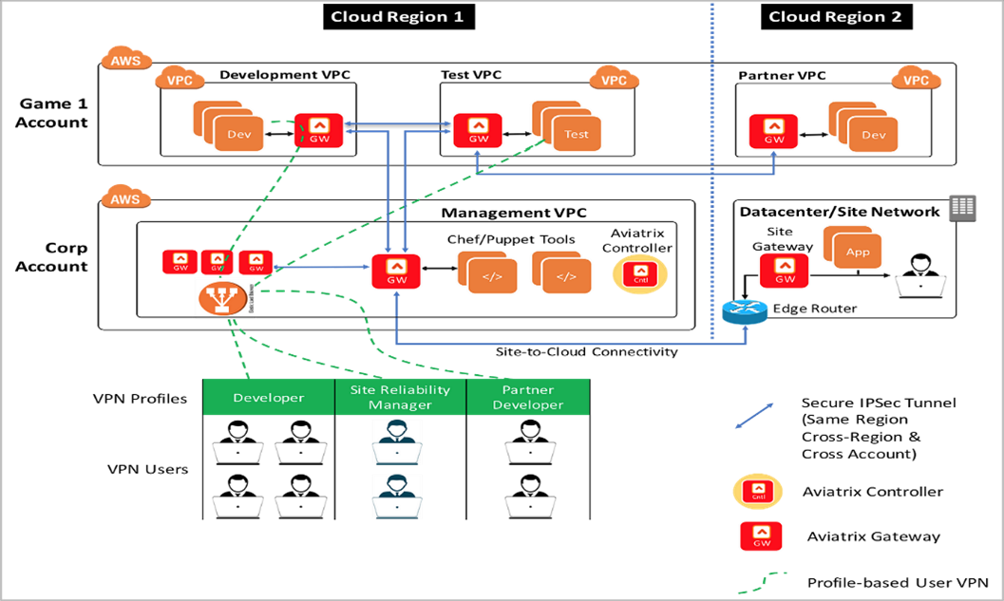
IMPLEMENTATION PLAN

Slide 25
NUMBERING RESOURCES
Short Message Service (SMS): Shortcodes or long virtual numbers for sending and receiving SMS messages.
Unstructured Supplementary Service Data (USSD): Shortcodes or USSD codes for accessing the service through mobile devices
Video Content: Shortcodes or dedicated numbers for accessing video content subscription services. Additionally, the provider may need bandwidth allocation or content delivery network (CDN) resources for streaming video content.
Sales of Data and Airtime: Shortcodes or dedicated numbers for processing data and airtime sales transactions. Additionally, the provider may need access to telecom infrastructure for airtime top-up services.
Mobile Gaming Applications: Shortcodes or dedicated numbers for accessing gaming services. Additionally, the provider may need server resources for hosting gaming applications and content delivery.

Slide 26

TECHNICAL AND COMMERCIAL PARTNERS
We're actively discussing integration with Telecel, a pivotal move for our operations, expanding our services and audience reach significantly.
However, our progress hinges on NCA license approval, which we're diligently pursuing to ensure seamless integration in compliance with regulations.
Our strategy emphasizes seamless integration with business partners and third-party collaborators to enrich our services and widen our reach, creating value for users and stakeholders through strong partnerships.
Additionally, our user integration plan emphasizes accessibility and user experience, striving to meet diverse needs and deliver a seamless, rewarding experience through continuous improvement and user feedback.

Slide 27
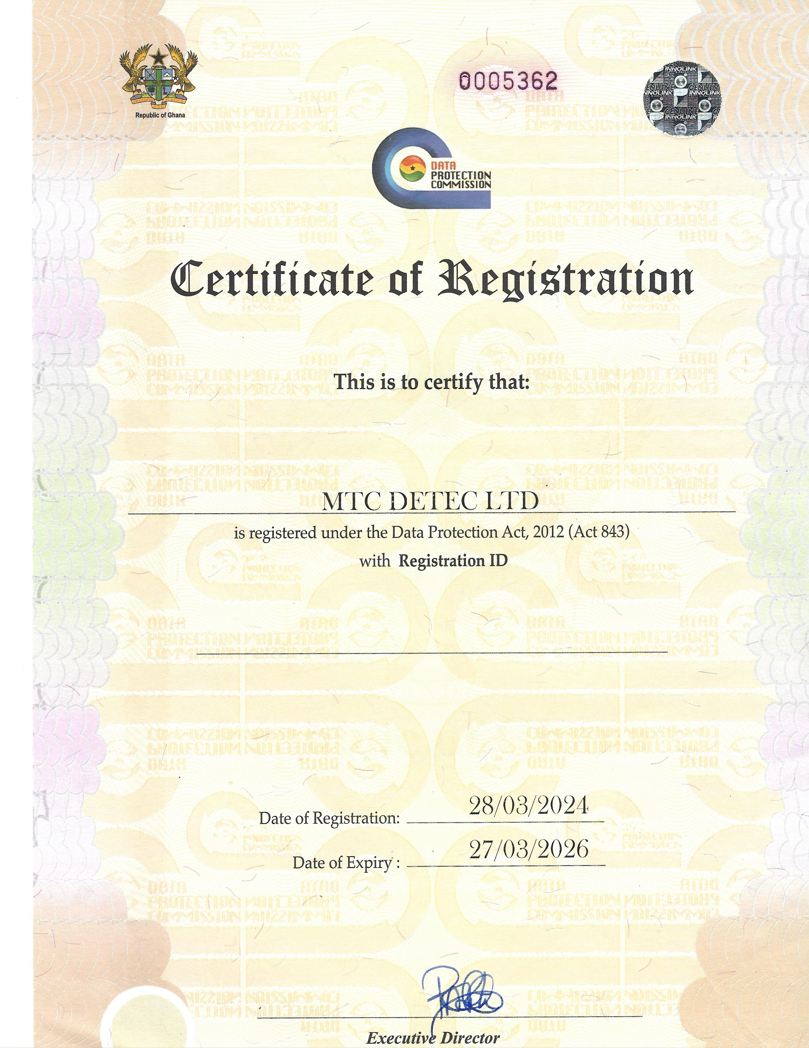
EVIDENCE OF AUTHORISATION

Slide 28
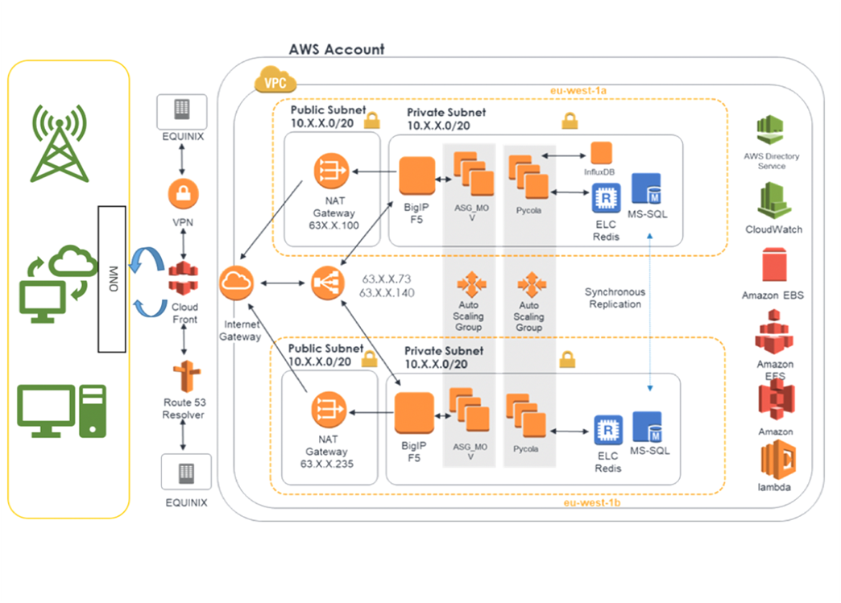
TECHNICAL IMPLEMENTATION PLAN

Slide 29
COMPLAINT HANDLING PROCEDURE
. Contact Channels:
Customers can reach out through multiple channels available 24/7: IVR, Phone Calls, WhatsApp and Email
Ticket Generation:
Upon submission, each complaint is assigned a unique ID for tracking.
Updates:
Customers receive regular progress updates on their complaints via their preferred communication channel.
Feedback:
Customer feedback is collected and analyzed to improve service quality.
Collaboration:
Internal channels facilitate teamwork and knowledge sharing among support teams.
Improvement:
Continuous review of feedback and proactive measures ensure ongoing service enhancement.

Slide 30

OTHER BUSINESS

Slide 31

THANK YOU

